Slide 1
Checkers
Charles Steelberg
Morgan Petrie
Afeefah Manzoor

Slide 2

How To Play
Closest to the top goes first
Select Piece
Move and/or Jump people
Become King
Be the last to survive

Slide 3

LETS PLAY

Slide 4
Hierarchy
Movement
Board
Player
King
Man

Slide 5
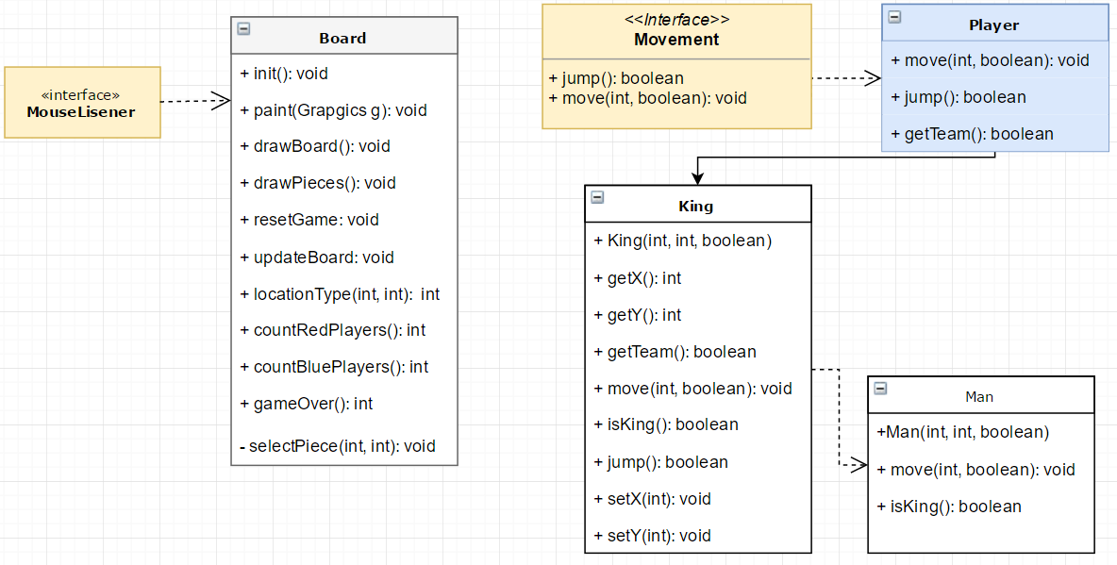
UML Diagram

Slide 6
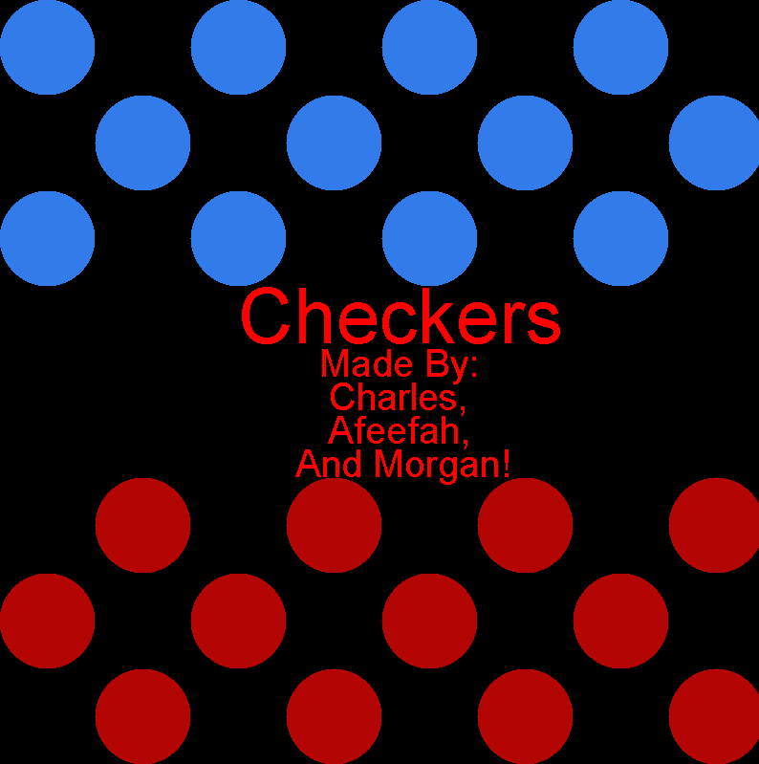
Board Class
Creates board
Creates & places pieces on the board
Checks for piece selected
Checks if piece is Kinged and on the right team
Calls move()
Resets game
Moves pieces
Game Over

Slide 7
Movement Interface
void move(int dir, boolean isJumping);
boolean jump();
Player Class
Abstract class
Implements Movement
abstract void move(int dir, boolean isJumping);
abstract boolean jump();
abstract boolean getTeam();

Slide 8
King Class
Man Class
Gets X & Y position
Sets new X & Y potions
Calls team color
Calls X & Y positions
Sets new X & Y positions

Slide 9
Polymorphism
King
Man
Move Method
Man is redefining Move
Move is going to be more specified

Slide 10
Special Features
The background changes color depending on whose turn
It’s hard to add “Special Features” to Checkers. Don’t judge me.

Slide 11
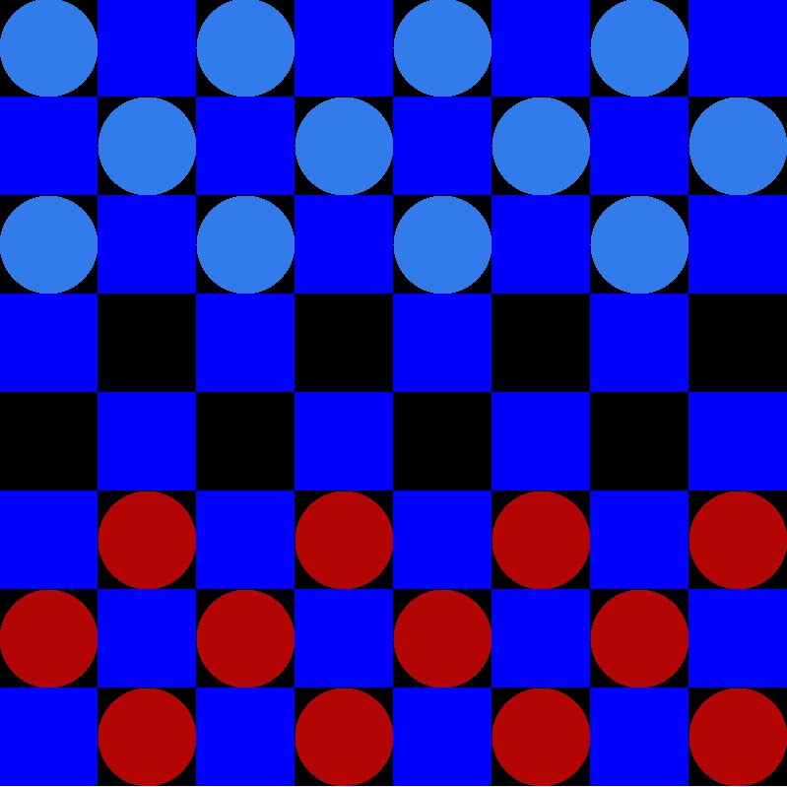
Bugs
public void mouseClicked(MouseEvent me) {
if(gameJustStarted){
checkAllSpawns();
gameJustStarted=false;
}
Piece selection
Second-Party Code
bufferGraphics.clearRect(0, 0, dim.width, dim.width);
bufferGraphics.setColor(Color.white);
bufferGraphics.fillRect(0, 0, 600, 600);
for (int i = 0; i <= 496; i = i + 80) {
for (int k = 0; k <= 496; k = k + 80) {
bufferGraphics.setColor(Color.black);
bufferGraphics.fillRect(i + 2, k + 2, 80, 80);
k = k + 24;
}
i = i + 24;
}
An old game Charles made last year
Mainly used to remember how to use
bufferedGraphics()
mouseEvent()
paint()

Slide 12
Conclusion
Difficulty Programming:
The idea overall wasn’t hard but getting the moving correct was tedious.
“Fun” Level:
This wasn’t that fun to make. You couldn’t make “Special Features” because it would just ruin the game.
Our Evaluation:
Charles
This was a good learning experience, but I wouldn’t do it again.
Afeefah
Ditto
What we learned:
Charles:
I learned the good and the bad things about working in teams.
Afeefah:
How BufferedGraphics & mouseListener worked.
Making a nice looking game is harder than it sounds like.

Slide 13
Questions?

